Slide 1
UROP PROJECT
Using symbolic execution to identify function IMPLEMENTATION inconsistencies across code revisions

Slide 2
The Problem
Developers push new code
Builds successfully and passes tests
But lots of new code usually means lots of changed functions
Do the new function implementations behave the same as the old ones?

Slide 3
Start
Has function behaviour changed?
Was it intended?
Possible bug
Yes
No
No
Yes
Stop

Slide 4
How do we test whether function behaviour has changed?
Examine history of function changes
Select interesting revision pairs
Compile two versions
Rename and link
Generate test drivers
Test with KLEE
Notes:
Examine history of function changes by using commit history of repository and running a git diff over pairs of consecutive commits.
Select pairs that you find “interesting”. Can be any criteria, although we may generally prefer to select revision pairs where lots of functions changed.
Compile two revisions of the same repository into LLVM bitcode archives
We use two strategies to avoid name clashes between global identifiers. For functions we simply rename them, adding a suffix to the end of the function name. For global variables, we use weak symbols to ensure that only one copy of the global variable is present in the final linked archive – strong symbols that share a name would yield an error during link time.

Slide 5
Examining History of Function Changes
Must be precise about which functions we test
Between any two revisions, we cannot test added or removed functions
Test only modified functions
But there are still some caveats

Slide 6
Has the function body changed?
Yes
Test
No
Has function signature changed?
Start
Yes
No
Yes
Is it simple renaming of parameters?
No
Ignore

Slide 7
How do we actually identify function changes?
Get pairs of commits
Generate Diff
Use regular expressions to identify functions
Then select “interesting” revision pairs

Slide 8
What do we mean by “interesting”?
Ideally, lots of modified functions
Few functions with signature changes
Many functions with body changes
Graph showing function changes…
Notes:
Comparing function with same name but different signature introduces a source of bias.
Many body changes increase the likelihood that the new function implementation behaves
Differently to the old one, and so the function in question is a prime candidate for testing.

Slide 9
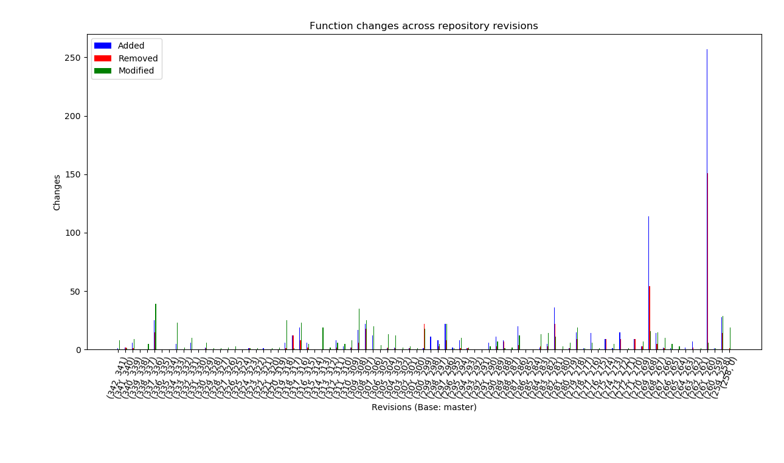
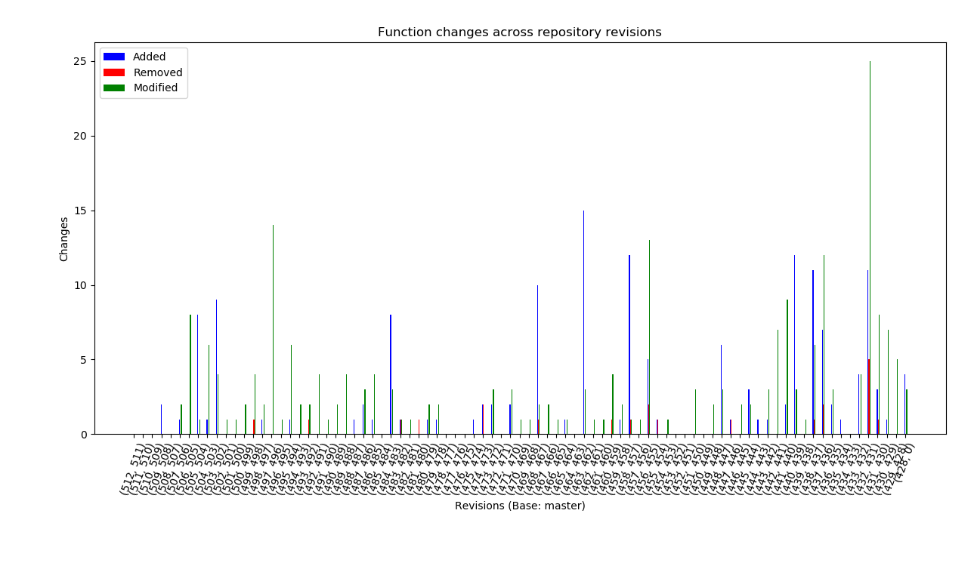
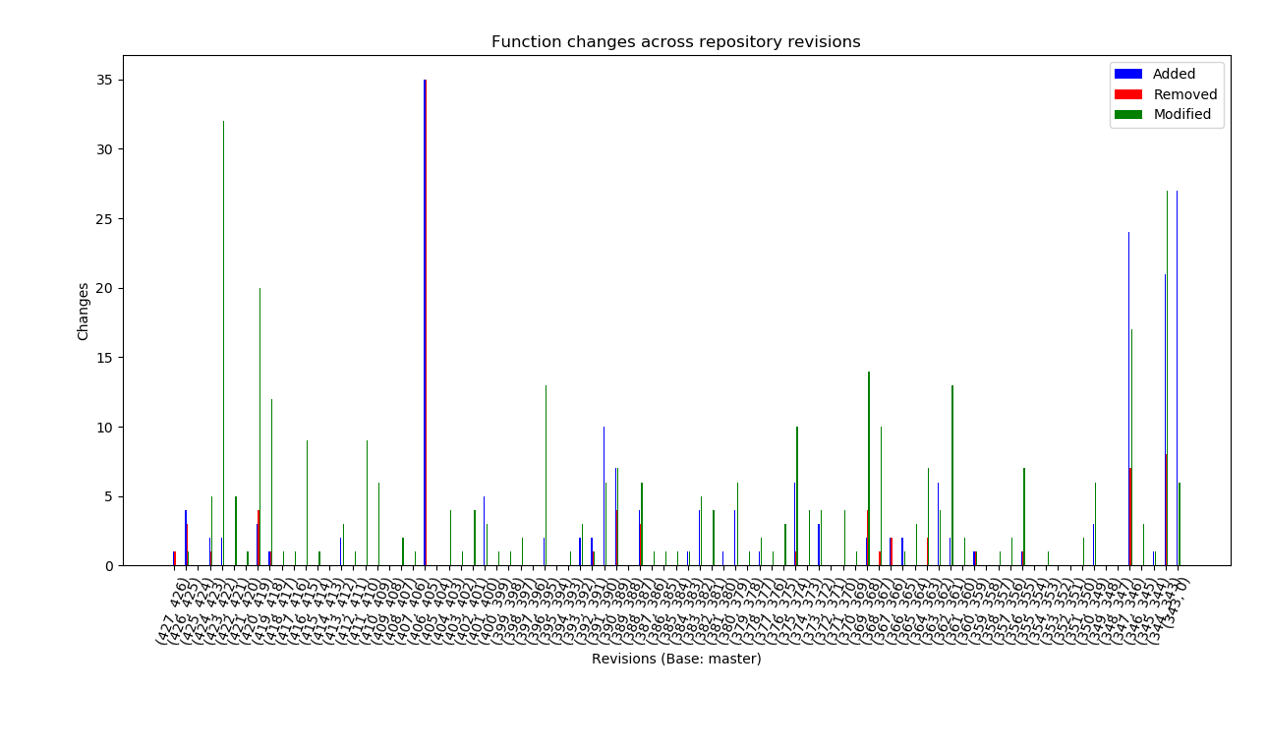
Repository History

Slide 10
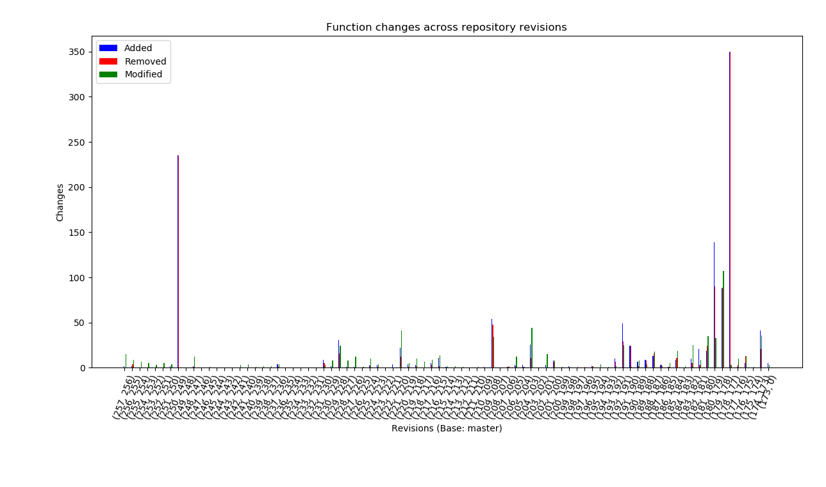
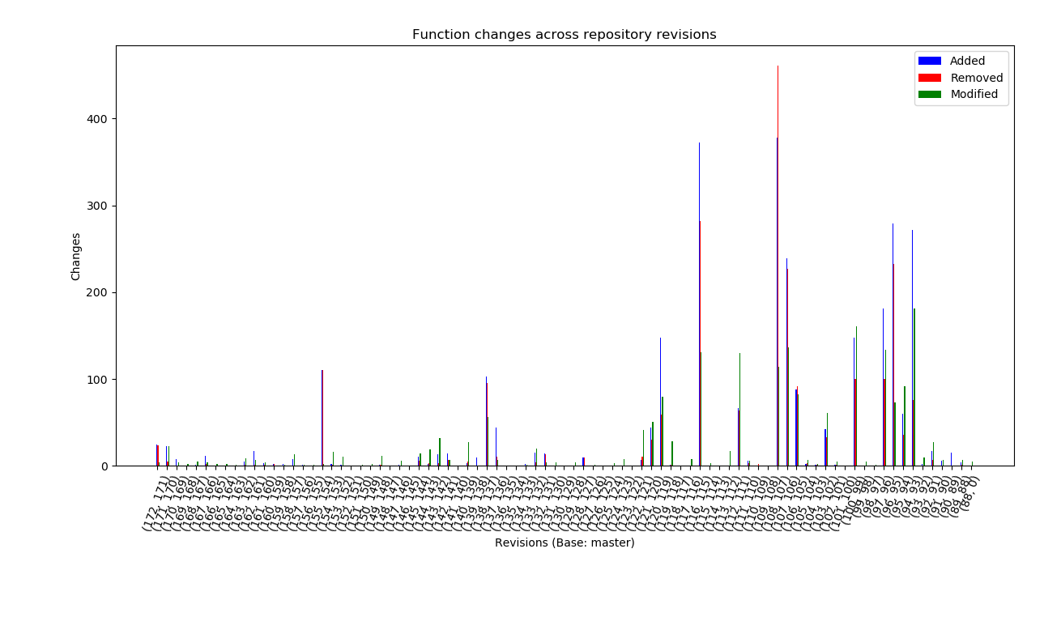
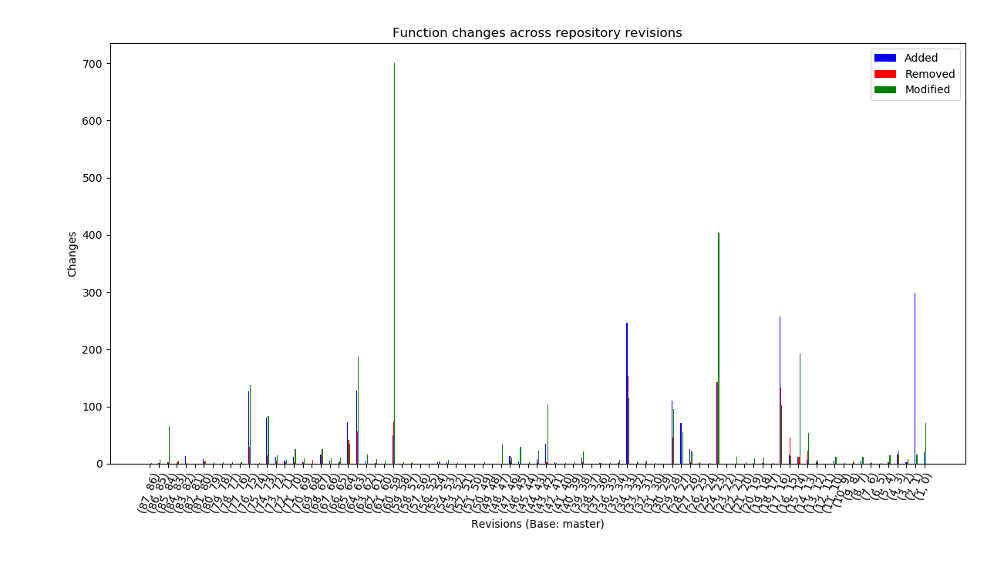
Repository History

Slide 11
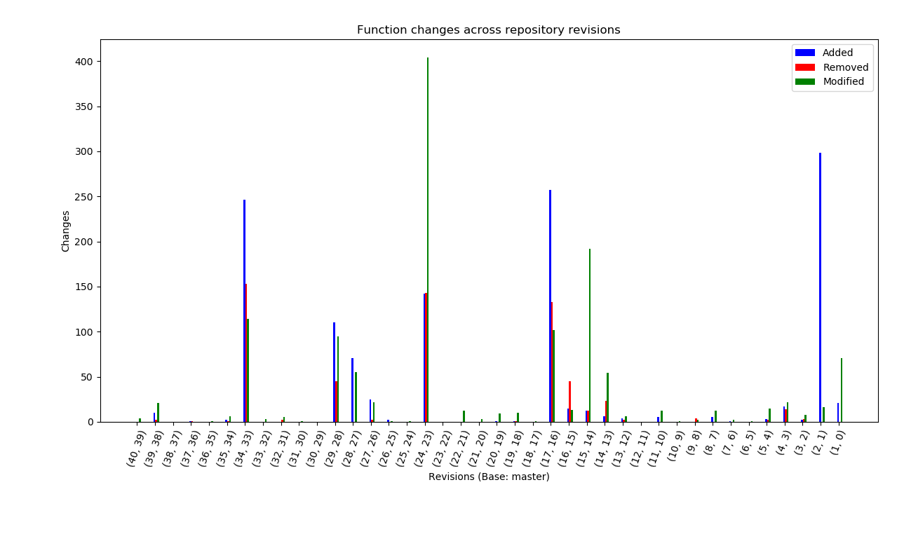
Repository History
Notes:
Here, “Modified” only refers to functions where the body has changed and the signature has remained the same. Not yet implemented functionality to check for renaming of parameters. Not yet fully verified functionality for detecting signature changes.

Slide 12
Compiling, Renaming and Linking
Clone
Clone repository and checkout revision
Make
Simple make command to build library archives
Rename
LLVM pass to rename functions in cloned archive
Link
Link both archives into single LLVM bitcode archive

Slide 13
Generating Test Drivers and Testing with KLEE
Python script to generate test drivers
Supply path of repository and pair of commits
Make command to compile tests to LLVM bitcode
Test with KLEE and gather results

Slide 14
KLEE Test Results
Test Driver | Instructions | Time(s) | Instr-cov(%) | Branch-cov(%) | Instr-Count | Time-Solver(%) | Test Cases | Notes
autotd5 | 4728 | 0.25 | 0.63 | 0.29 | 52623 | 50.30 | 2
autotd11 | 4766 | 0.16 | 0.66 | 0.32 | 52621 | 0.01 | 1
autotd15 | 26475 | 472.50 | 0.66 | 0.35 | 52623 | 83.54 | 13 | Fork Failed (STP)
autotd20 | 4741 | 0.07 | 0.62 | 0.28 | 52621 | 0.02 | 1
autotd25 | 4737 | 368.61 | 0.61 | 0.27 | 52621 | 87.27 | 2 | Fork Failed (STP)
autotd30 | 4739 | 0.07 | 0.62 | 0.28 | 52621 | 0.02 | 1
autotd35 | 4739 | 0.07 | 0.62 | 0.28 | 52621 | 0.02 | 1
autotd40 | 6784 | 199.98 | 0.82 | 0.63 | 52639 | 74.86 | 16 | Fork Failed (STP)
autotd45 | 5499 | 351.99 | 0.96 | 0.58 | 52654 | 20.69 | 10
autotd50 | 4741 | 0.07 | 0.62 | 0.28 | 52621 | 0.08 | 1
autotd55 | 4774 | 0.18 | 0.65 | 0.34 | 52623 | 9.20 | 3
autotd60 | 5393 | 0.11 | 0.88 | 0.50 | 52647 | 10.46 | 5
autotd65 | 4929 | 437.15 | 0.78 | 0.44 | 52656 | 28.89 | 4 | Fork Failed (STP)
autotd70 | 4750 | 0.09 | 0.64 | 0.28 | 52628 | 0.02 | 1
autotd75 | 4752 | 0.07 | 0.64 | 0.28 | 52628 | 8.36 | 1
autotd80 | 4766 | 0.13 | 0.66 | 0.32 | 52621 | 0.01 | 1
autotd85 | 4794 | 0.07 | 0.72 | 0.35 | 52654 | 0.04 | 1
autotd90 | 4741 | 1199.69 | 0.62 | 0.31 | 52628 | 95.79 | 1 | STP return error
autotd95 | 4759 | 0.08 | 0.66 | 0.28 | 52621 | 0.02 | 1
autotd100 | 4747 | 397.18 | 0.61 | 0.27 | 52623 | 74.72 | 2 | Fork Failed (STP)
Revision Pair: (master~15, master~14)

Slide 15
Tutorial
Notes:
Setup environment if not done already
Open XMing
$env:DISPLAY=“localhost:0.0”
vagrant ssh (may need to run ‘vagrant up’ if prompted)
Once in vagrant environment, go to UROP directory ($HOME/UROP)
Everything should already be compiled (revisions: master~15 master~14) to save time.
Generate graph to find “interesting” revisions
./diff_function.py –r third_party/upb --commits master --depth 20 --show-graph
Show modified functions for interesting revision pair
./diff_function.py –r third_party/upb --commits master~15 master~14 --show-functions
I have already compiled everything to save time, but if we hadn’t, we would run
export LLVM_COMPILER=clang
SHA1=master~15 SHA2=master~14 make LLVM_VERSION=3.4 (to compile two revisions of library)
git –C third_party/upb diff master~15 HEAD (to confirm revisions checked out properly)
git –C third_party/upb-2 diff master~14 HEAD (to confirm revisions checked out properly)
./autogen.py –r third_party/upb --commits master~15 master~14
make autotests (to compile the test drivers to LLVM bitcode)
Now we can test the modified functions with KLEE, using the generated test drivers
cd obj
klee –libc=uclibc –link-llvm-lib=boilerplate.bc –link-llvm-lib=libupb_all.a.bc autotd1.bc
klee-stats .

